Slide 1
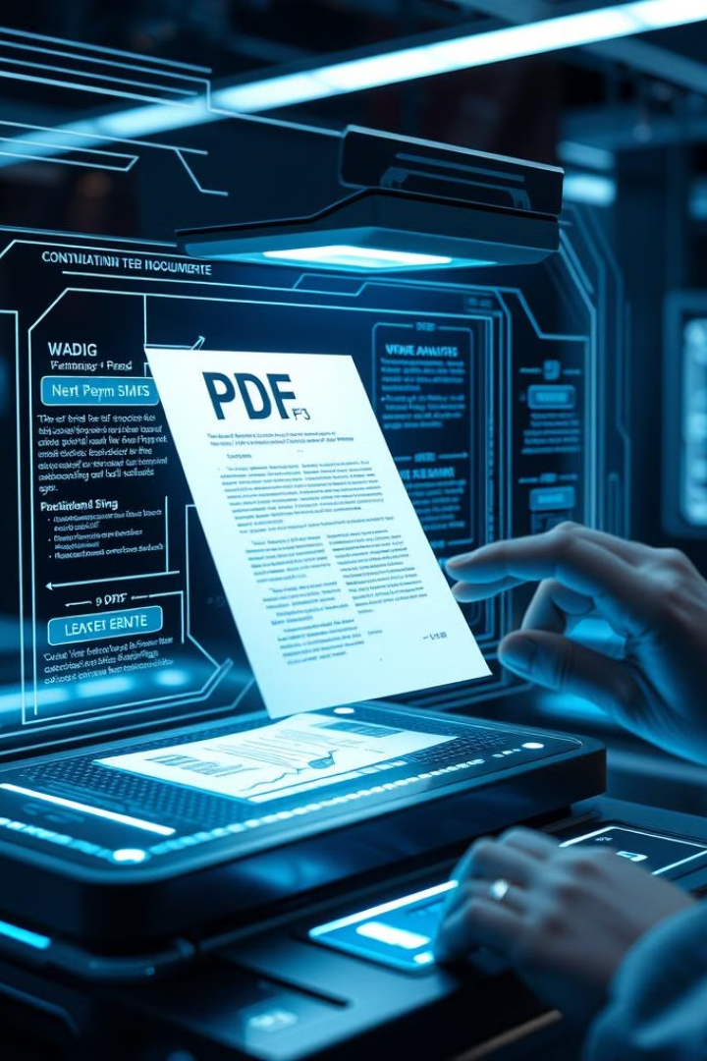
PDF Parser for Prajna AI
An intelligent tool for extracting and analyzing text from PDF documents. Designed for AI-driven applications, it offers advanced parsing capabilities with an intuitive interface.
By AI Developers

Slide 2
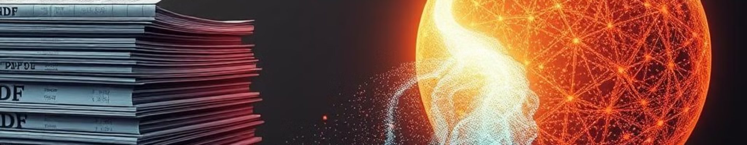
Key Features
1
PDF Ingestion
2
Embedding Generation
Upload and parse PDF documents accurately, preserving content structure.
Create semantic embeddings for efficient content retrieval and querying.
3
Question Suggestion
4
Natural Language Querying
Automatically generate relevant questions based on document content.
Allow users to submit queries and receive accurate answers.

Slide 3
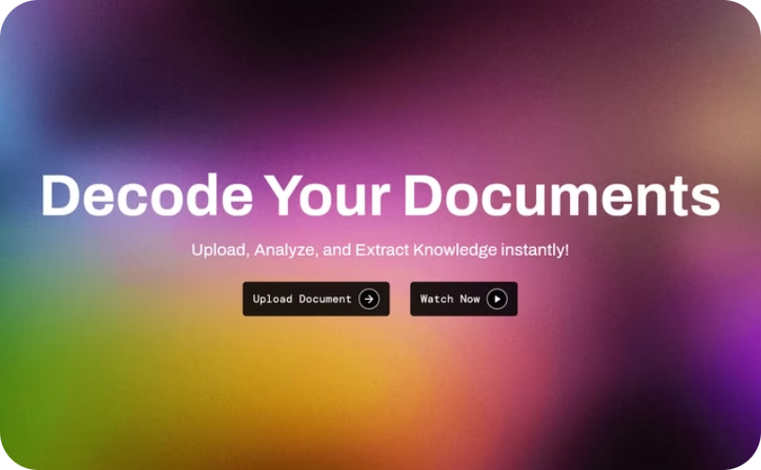
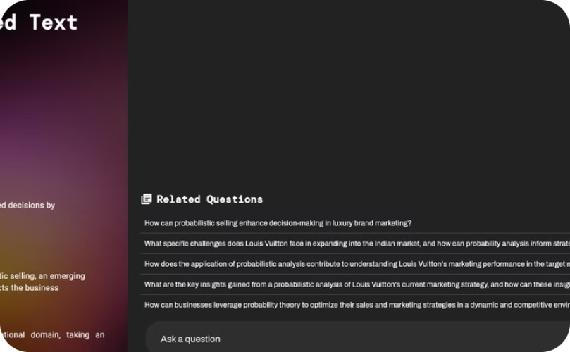
User Interface
Document Upload
Question Suggestions
Simple interface for uploading PDF files and viewing extracted content.
Automatically generated questions based on document content.

Slide 4
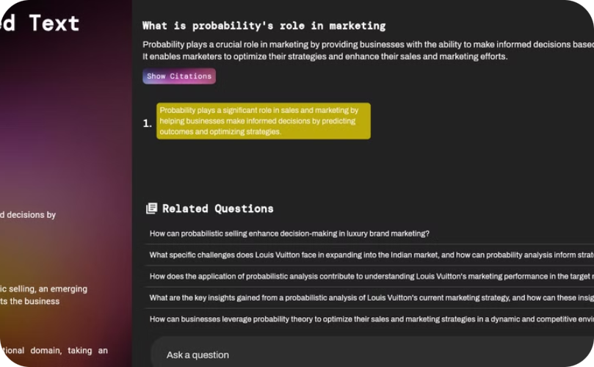
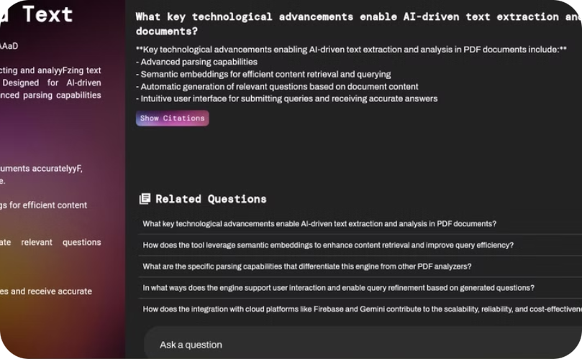
Querying and Results
Response with Citations
Accurate answers provided with citations to source material.

Slide 5
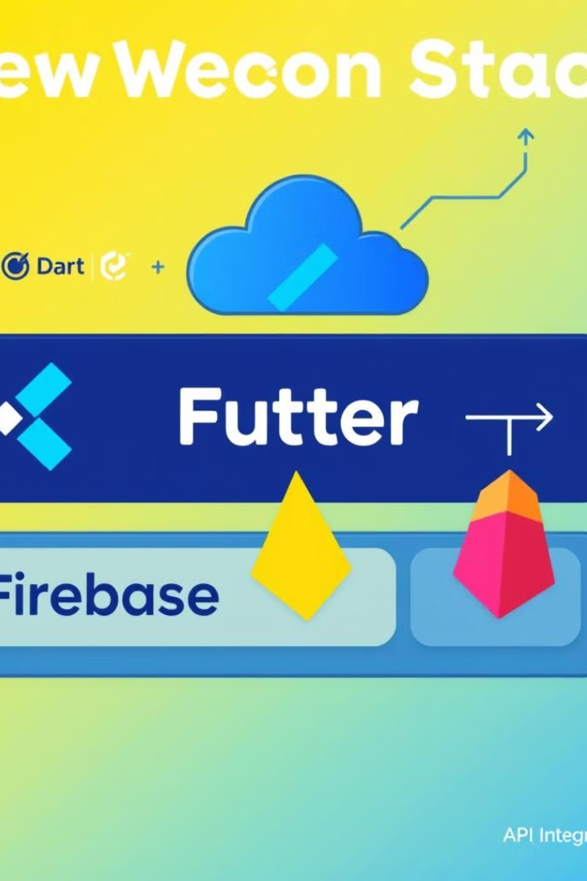



Technology Stack
Cloud Deployment
Scalable and reliable cloud-based deployment for using Firebase.
API Integration
Cost-effective use of APIs using Gemini.
Efficient Storage
Optimized data persistence for quick retrieval and querying using Firestore by firebase

Slide 6

Development Process
Problem Analysis
1
Understanding the challenge of extracting insights from unstructured PDF data.
2
Solution Design
Crafting an intelligent system with advanced parsing and querying capabilities.
Implementation
3
Developing the core features and user interface during the hackathon.
4
Deployment
Launching the system on a cloud platform for public access.

Slide 7
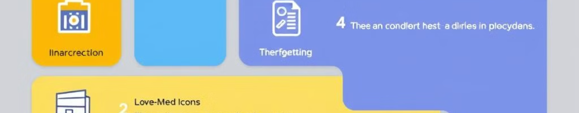




How to Use
Access Website
Upload PDF
Explore Features
Review Results
Visit the deployed application at pdf-parser-88393.web.app.
Use the provided demo PDF for optimal results.
Interact with suggested questions or input custom queries.
Examine answers and citations provided by the system.

Slide 8
Team AI Developers
Expertise
Collaboration
Innovation
IT and Data Science freshers from NIT Jalandhar.
Effective teamwork to deliver a complex solution in a short timeframe.
Creative approach to solving document analysis challenges.

